Slide 1
NLP

Slide 2
Introduction to NLP
Deep Learning for NLP

Slide 3
Deep Learning for NLP
Input:
words, sentences, documents
Neural networks expect continuous vectors:
word embeddings (next lecture), sentence embeddings, document embeddings
For sequence of variable length
Use recurrent neural nets (RNN), e.g., LSTM

Slide 4
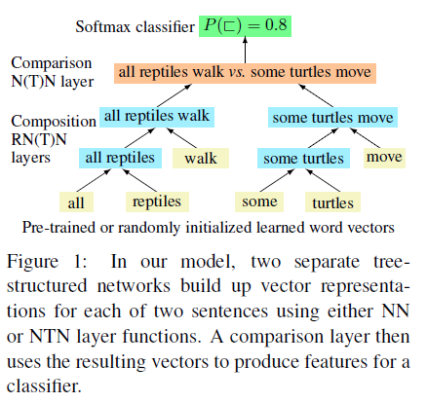
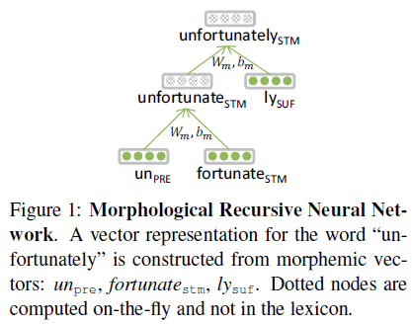
NLP Examples
[Thang et al. 2013]
[Bowman et al. 2014]

Slide 5
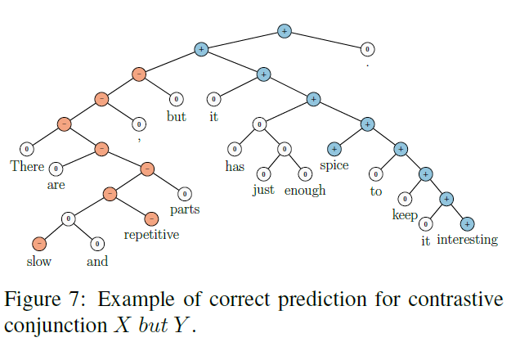
Sentiment Analysis
[Socher et al. 2013]

Slide 6
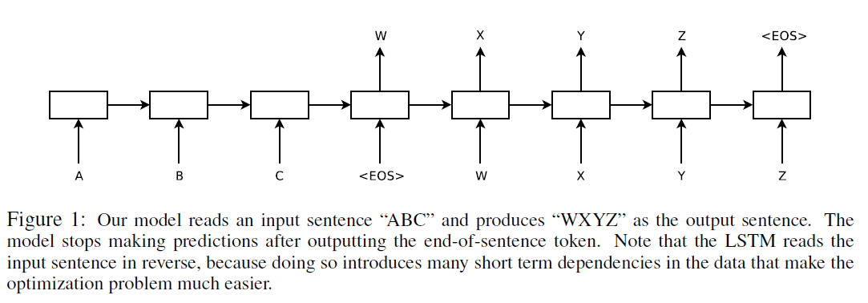
Machine Translation
Sequence-to-sequence
[Sutskever et al. 2014]

Slide 7
Coreference Resolution
[Clark and Manning 2016]

Slide 8
Input Reordering
(Botha et al. 2017)

Slide 9
NLP

